Slide 1
Rasberry pi heat alarm
Created by lee Thornton, 20041034

Slide 2
Block level representation of project
Temperature Sensor
Data stored in Raspberry Pi
Temperature Data indicated on raspberry pi SenseHat
Temperature displayed on Wia
User contacted using thingtweet if temperature indicates fire possibility
Temperature data shown using Blynk app
Sprinkler system activated once temperature breaches 50 degrees

Slide 3
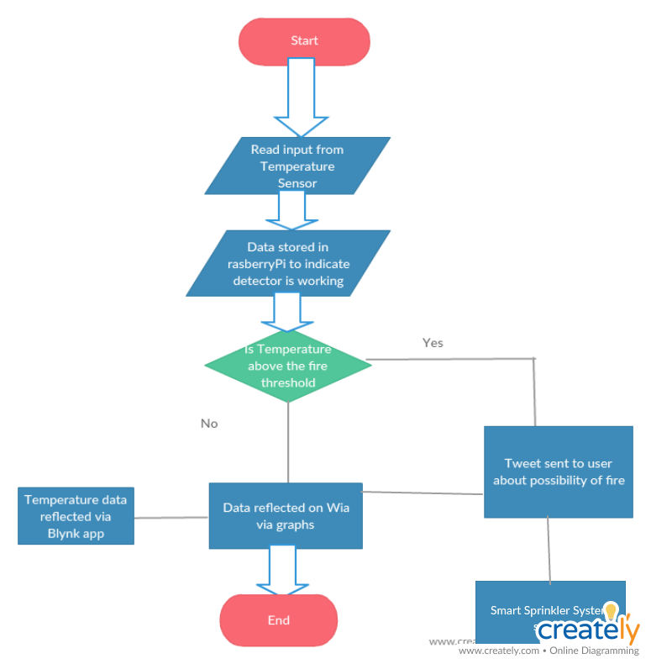
Flowchart

Slide 4
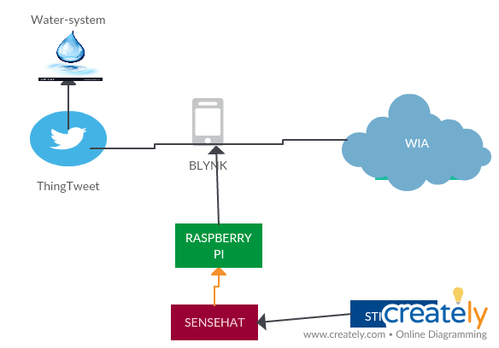
Informational flow Diagram

Slide 5
Deliverables
From the above diagrams the goal of the system is to provide heat updates to the user & once a certain threshold is surpassed then to Alert the user to the possibility of a fire.
Sense hat is used for the first step where heat data is taken & stored. Heat readings will always be stored regardless if the threshold is broken or not to indicate to the user that the device is working.
The logic point I focused on is if the heat temperature goes beyond (50 degrees) then this indicates a fire & the user is notified via tweet, also sprinklers will be set off once hear rises above 50 degrees.

Slide 6
Deliverables (part 2)
Sense Hat will also be used to indicate heat, I plan on used a traffic light system, green for ok, orange when heat is starting to become close to the threshold & red when the threshold has been surpassed.
Finally all data will be stored & displayed using Wia & Blynk, this allows the user to check the device is working correctly & also as a by-product indicates visually to the user the heat of their house over a certain period of time.

